Slide 1
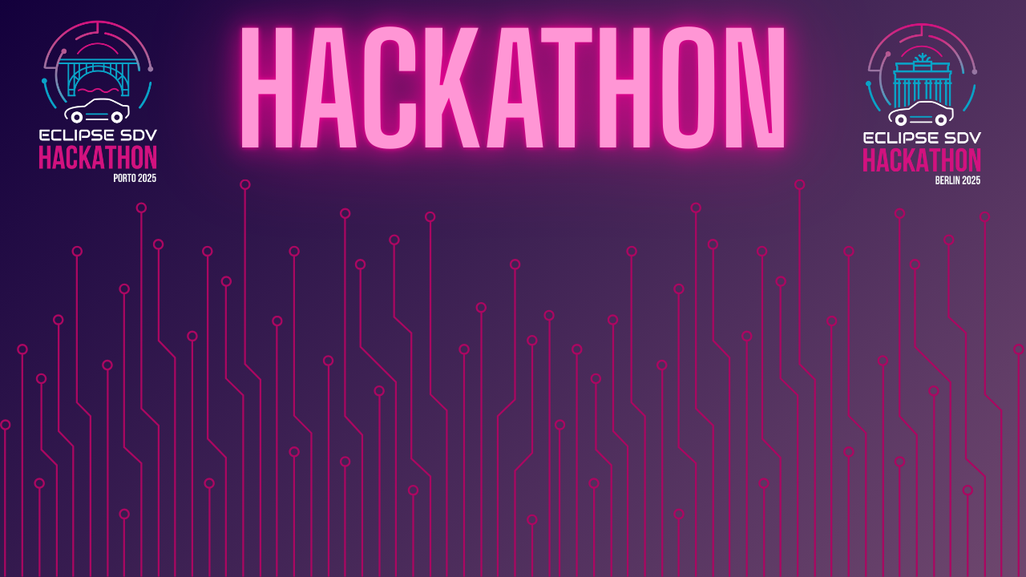

Chapter III - 2025
COPYRIGHT (C) 2025, ECLIPSE FOUNDATION

Slide 2
Eclipse Hackathon SDV Ready Set Drive
COPYRIGHT (C) 2025, ECLIPSE FOUNDATION
Notes:
Hello everyone, my name is Kijin Baek and I will be presenting on behalf of my team today. Our team is called RSD,

Slide 3

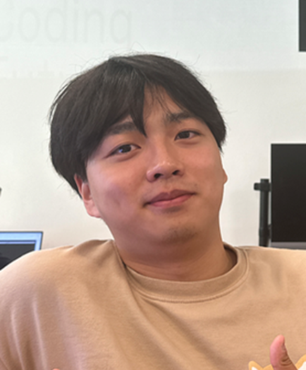
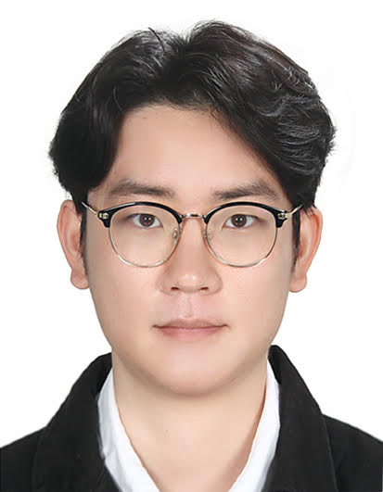
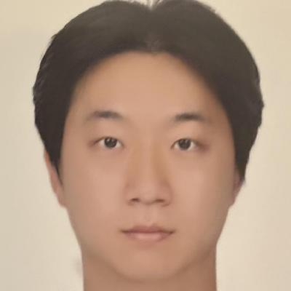
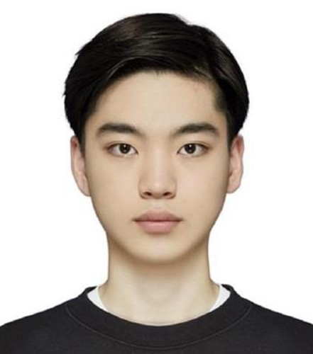
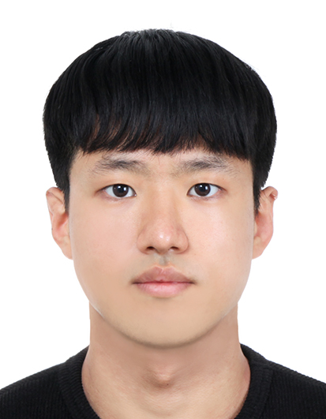
Member of RSD
Younggyo Oh
Leader
Gihoon Kim
Developer
Kijin Baek Developer
Siwoo Lee Developer
Changseok Oh Developer
Notes:
and my teammates are [Changseok Oh], [Gihoon Kim], [Siwoo Lee] and [Younggyo Oh]. We are university students from Korea, currently in Germany as part of the SEA:ME program, and we joined this hackathon to meet new people and to gain experience.

Slide 4
Plan – Virtual SDV Lab Challenge
Safety
Convenience
Cruise Control
Road Condition
Aware ADAS
Road
Weather
Emerge​ncy
Cost
Notes:
When we first heard about the Virtual SDV Lab Challenge, some words came to our minds: safety, convenience, road, weather, emergency, and so on. These words show what we think is important in this challenge. After we talked about them together, we chose our main topic: Road Condition Aware ADAS. In short, we made lane keeping and ACC, and we also added road surface check to keep a safe distance. I will explain this more later

Slide 5
Plan
: Progress
Contents | Details | Day 1 |  |  | Day 2 |  |  | Day 3
Brain Storming | Ideation
 | Task Assignment
Environment Setup | Carla Simulator
 | Zenoh, Kuksa, Ankios
Implementation | ACC / LK Algorithm
 | Road Condition Recognition
 | Integration
 | Scenario Test
Feedback & Maintenance | Gain Tuning
 | Data Analysis
Notes:
This slide shows our plan and how we worked through each day. On Day 1, we focused on brainstorming, assigning tasks, and setting up the environment. On Day 2, we worked on algorithms, road condition recognition, and started integration. On Day 3, we tested scenarios, tuned the system, and analyzed the results

Slide 6
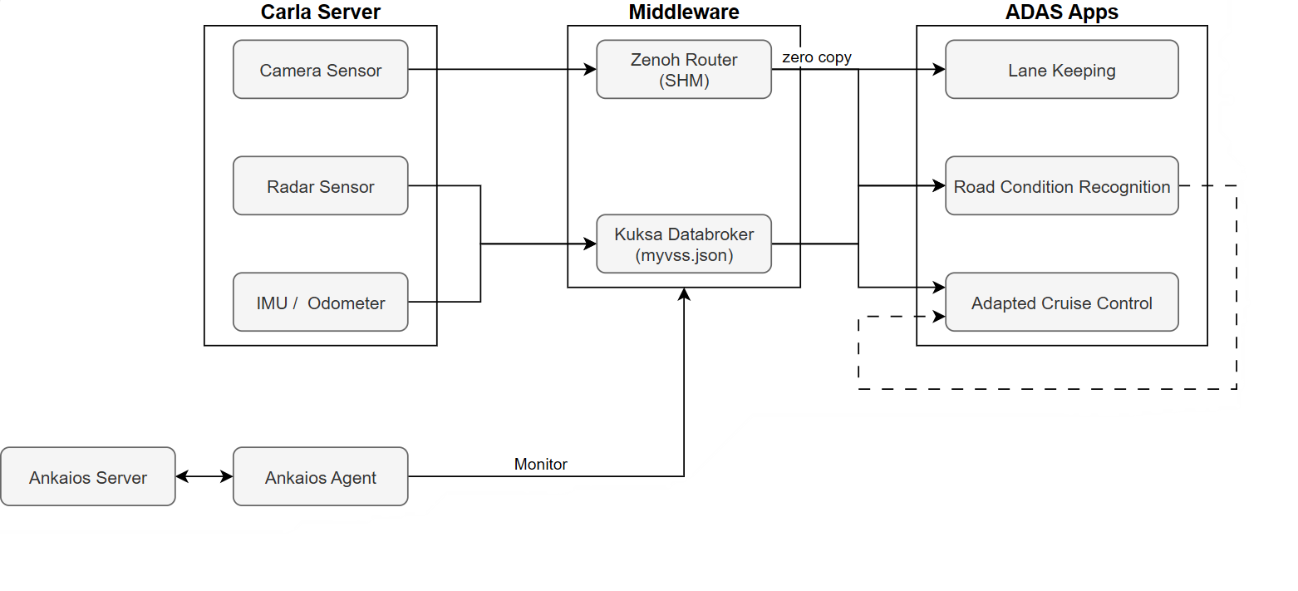
System Architecture
Notes:
This slide shows our system architecture. On the left side, the Carla server provides sensor data, such as the camera, radar, and IMU. These data are sent to the middleware. In the middleware, we use Zenoh for fast data sharing and Kuksa Databroker to organize the signals in the VSS format. On the right side, our ADAS applications – lane keeping, road condition recognition, and adaptive cruise control – use this data to make driving decisions. At the bottom, we also connected Ankaios to monitor the system. This structure makes it easier to integrate and manage each module. In our system, the radar is used for longitudinal control. It provides the distance and speed to the car in front, and we use that to control throttle and brake. The camera is used for lateral control. We set an ROI on the lane, detect the two lane lines, and calculate the center between them. The car then follows this center with steering control. In addition, the camera also helps to check the road surface by brightness, color, and light reflection. Together with IMU and wheel odometer data, we estimate the road condition. When the slip ratio becomes higher, our system keeps a larger and safer distance. This way, both safety and stability are improved

Slide 7
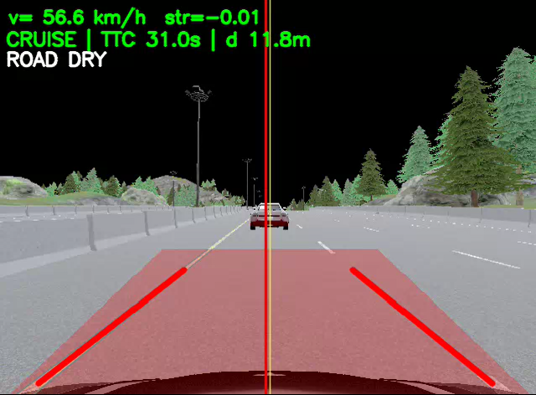
Video

Slide 8
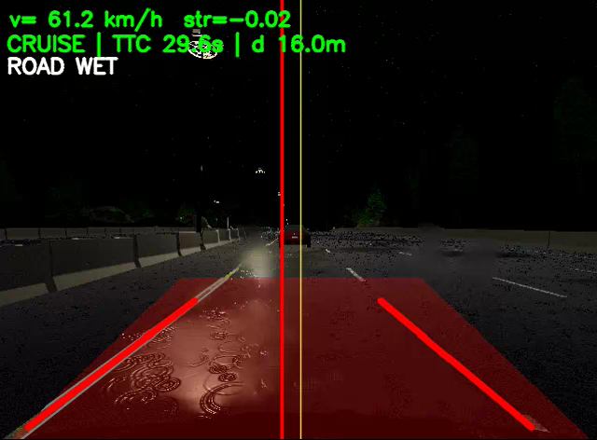
Video

Slide 9
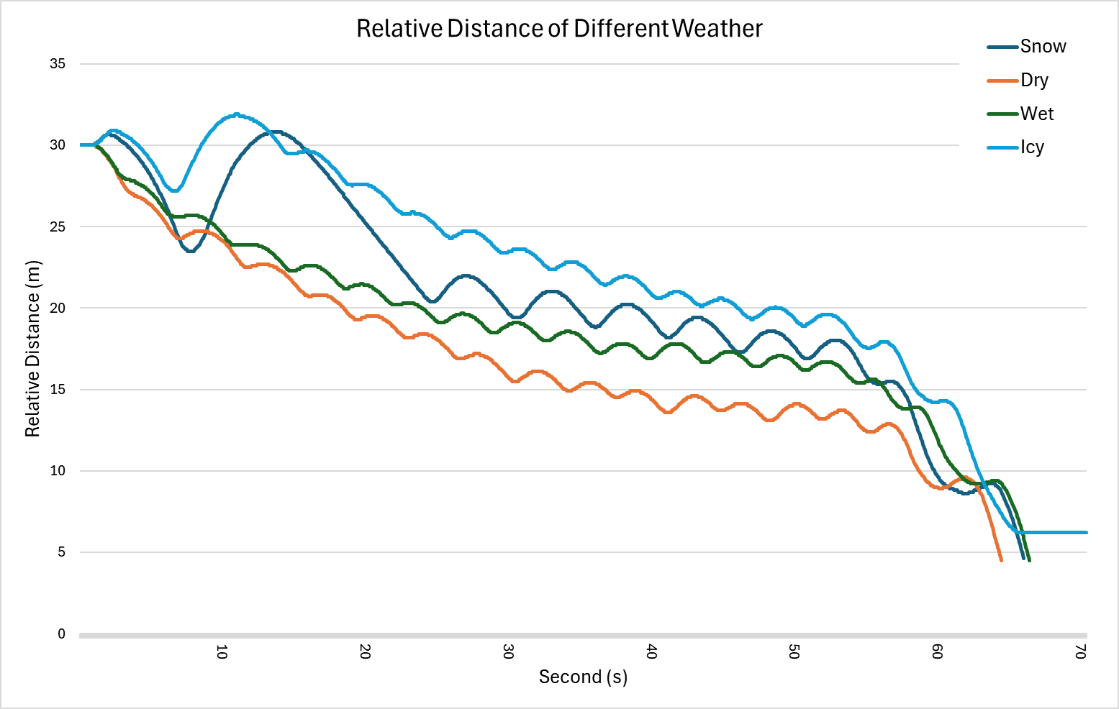
Result
Notes:
As a result, this graph shows the relative distance in different road conditions: dry, wet, icy, and snow. At the beginning there is a small jump error, but overall you can see the difference clearly. On dry roads, the distance is the smallest. On wet, icy, and snowy roads, the system keeps more distance. When the road gets worse, our system keeps more distance for safety

Slide 10
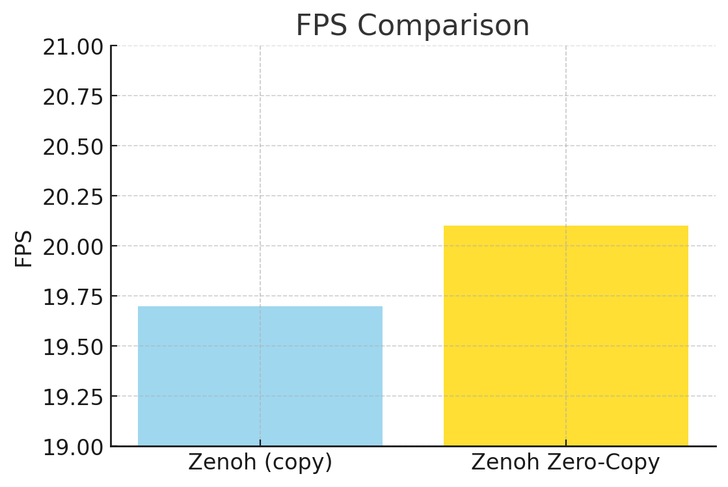
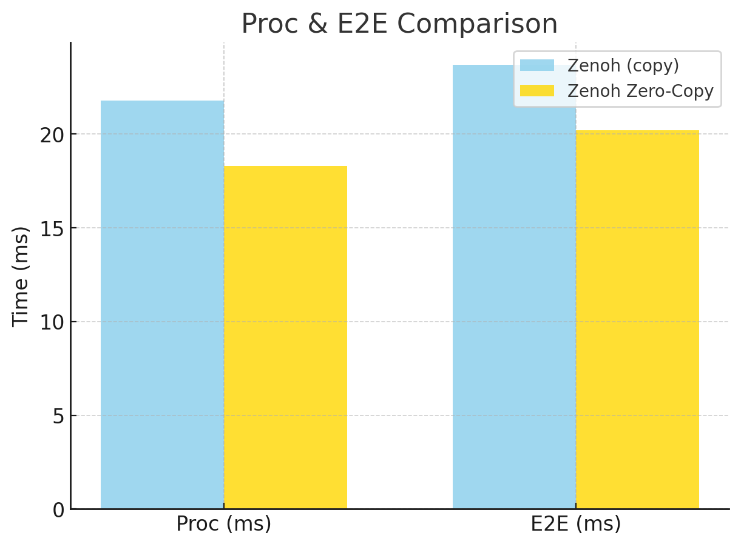
Result
14.7%
10.7%
2.47%

Slide 11
The Market & The Competition
Easily Deployable
Can update via OTA
Integration on existing hardware
Cost-Effective
Low cost, high performance
Affordable path to enhanced ADAS safety
Notes:
Here we talk about the market and the competition. First, our solution is easily deployable. It can be updated over-the-air, and it can also be integrated on existing hardware without big changes. Second, our solution is cost-effective. It offers low cost with high performance, and it gives an affordable way to improve ADAS safety. These points make our solution attractive compared to other approaches in the market

Slide 12
Business Model * Plan & Funds
Sales / Revenue Model
Required Funds
B2B Licensing to
OEMs & Tier-1s
R&D​
Validation & Testing
Subscription / SaaS
for SDVs
Business Development
Notes:
🔹 1. Sales / Revenue Model (How to generate sales)
B2B Licensing to OEMs & Tier-1s
자동차 제조사(OEM)와 ADAS 공급업체(Tier-1)에 소프트웨어 모듈 라이선스 제공
RCR 모듈을 기존 ACC/AEB 소프트웨어에 통합 → 차량 안전성 강화
Subscription / SaaS for SDVs
차량이 Software-Defined Vehicle로 가면서 OTA 업데이트 기반
노면 인식 기능을 구독형 서비스로 제공 (예: 매년 기능 업데이트)
🔹 2. Required Funds (예상 자금 & 사용처)
R&D: 알고리즘 고도화 (머신러닝 기반 분류), 시뮬레이션 인프라(CARLA 서버, 클라우드)
Validation & Testing: 실제 도로 시험, 다양한 날씨 조건에서의 검증 비용
Business Development: OEM/Tier-1과의 협력, 라이선스 계약, 마케팅
Total: 초기 Seed Fund (예: 500k~1M € 수준) → 2년 내 PoC → 상용화

Slide 13
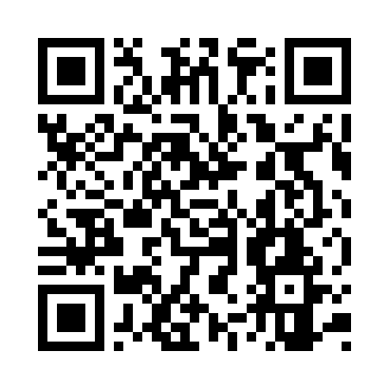


Contact
Team RSD
Github QRcode
Younggyo Oh
https://github.com/oyg0323 oyg0323@gmail.com
Siwoo Lee
https://github.com/Siwoo248 siwoo0408@kookmin.ac.kr
Gihoon Kim
https://github.com/JoeyGihoon gihoon00@gmail.com
Changseok Oh
https://github.com/Changseok-Oh29 changseo29@gmail.com
Kijin Baek
https://github.com/kiiznii 429jin@kookmin.ac.kr

Slide 14
Thank You
Team RSD
COPYRIGHT (C) 2025, ECLIPSE FOUNDATION

